Slide 1

BENCHMARK CANADA 2026
Research webinar & overview

Slide 2
BENCHMARK CANADA 2026
Webinar Agenda
Timeline
Research Documents:
  Questionnaire (including new areas)
  Client & Professional References
How To Submit
Partner Interviews
Firm Rankings
Litigation and Future Stars
Special Hono(u)rs
Practitioner Survey
Why Participate?
Q&A
Thank You

Slide 3
RESEARCH TIMELINE
OCTOBER 1, 2025 –Documents available: Questionnaire & Client Referee template
OCTOBER 27, 2025 – JANUARY 23, 2026 – Partner interviews conducted
NOVEMBER 5, 2025 – Practitioner Survey distributed
DECEMBER 5, 2025 – DEADLINE for Research Documents
JANUARY 5, 2026 – Client Survey distributed
MARCH 23, 2026– Awards Shortlist announced
MAY 6, 2026– Firm Rankings & Lawyer Rankings published
May 2026 – Awards Gala (exact date TBD)

Slide 4
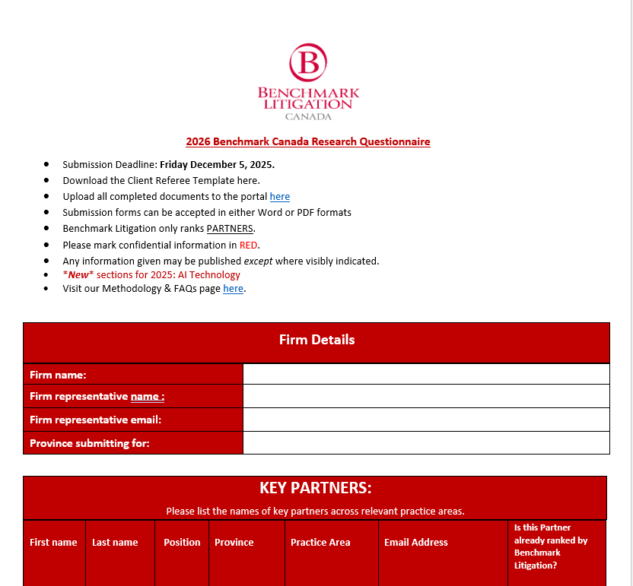
COMPLETION OF THE QUESTIONNAIRE
The purpose of the Questionnaire is to tell the story of the firm’s litigation capacity, specifically as it pertains to the past year:
Highlight key practice areas (where applicable) in which the firm has particularly excelled in the past year
Mention key partners who you would consider the firm’s leaders and up-and-comers in said key areas. THESE CAN BE THOSE ALREADY RECOGNIZED BY BENCHMARK OR NEW CANDIDATES.
Provide details on cases and mandates that demonstrate these strengths in the “Representative Work” section.
Mark clearly in RED any confidential information that you do not want published
Extensions may be granted upon request (and within reason)

Slide 5
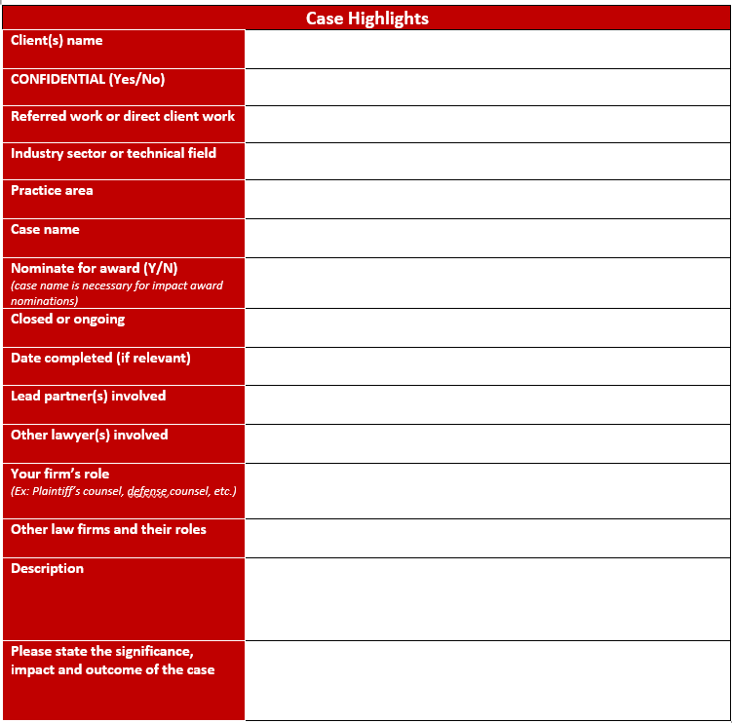
REPRESENTATIVE WORK SECTION
If there are any aspects of confidentiality to any work you are highlighting, of if they are fully confidential, PLEASE take whatever steps necessary to denote this in order to fully safeguard it from being published.
Industry sector not necessary but helpful
If you would like this case to be considered as a potential “impact case” at our annual award ceremony, we will need to know the case name. Criteria considered in these “impact case” selections are legal novelty, financial significance, social gravity (pro bono counts!), precedence set, etc. Impact case winners had to have met with decisive conclusions within the past 12 months, and the winning firm must be the victor in the case. No cases of “ongoing” status will be considered. If a decision is being appealed, this can be noted in the “description” field, but if a decision has been rendered, please mark the status as “closed” and provide the date. Provides greater clarity when canvassing for potential impact case award winners.
Please be honest with the name(s) of lead partner(s.) List those that actually did the work (and not just those that wield the most political influence internally) so that we can properly attribute credit. As for the other lawyer(s) on the team involved, you should only include the PARTNERS.
Other law firms and their roles is very helpful but not necessary.
Tell the story of the case – what happened, to whom, when, why, etc. – in the simplest terms. Avoid too much potentially confusing jargon and legalese. Feel free to expound upon the significance and outcome with factual content concerning novelty or precedence set, etc. but please avoid spin and puffery that just adds bulk to the text but adds little value. Please also be clear as to whether it was a win, lose or draw. IT’S OK TO ADMIT YOU LOST! Your involvement in the case is what counts. AND YES, IF YOU ALREADY PROVIDED THIS CONTENT TO OTHERS, YOU CAN JUST COPY AND PASTE HERE.

Slide 6
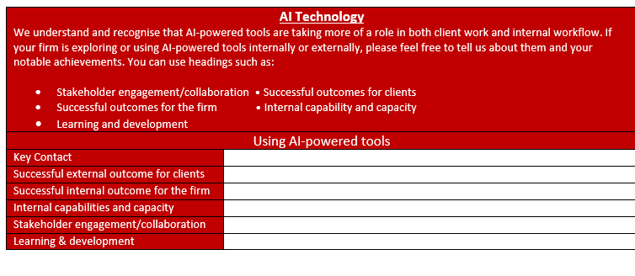
*NEW* 2026 QUESTION: AI TECHNOLOGY

Slide 7
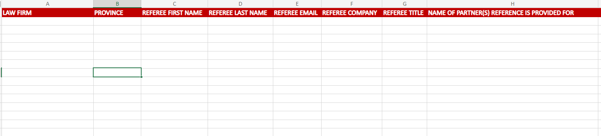
COMPLETION OF THE CLIENT & PROFESSIONAL REFERENCES
PROVIDE RELEVANT CLIENT REFERENCES USING THE TEMPLATE PROVIDED
Timeliness is particularly of the essence with this aspect of the submission process
It is especially critical to submit your references on time for greater chances of a response
Do not change the structure or layout of the template – these MUST be submitted as such. Any ones that aren’t won’t be accepted.
All references will be contacted with the Client & Professional References Survey

Slide 8
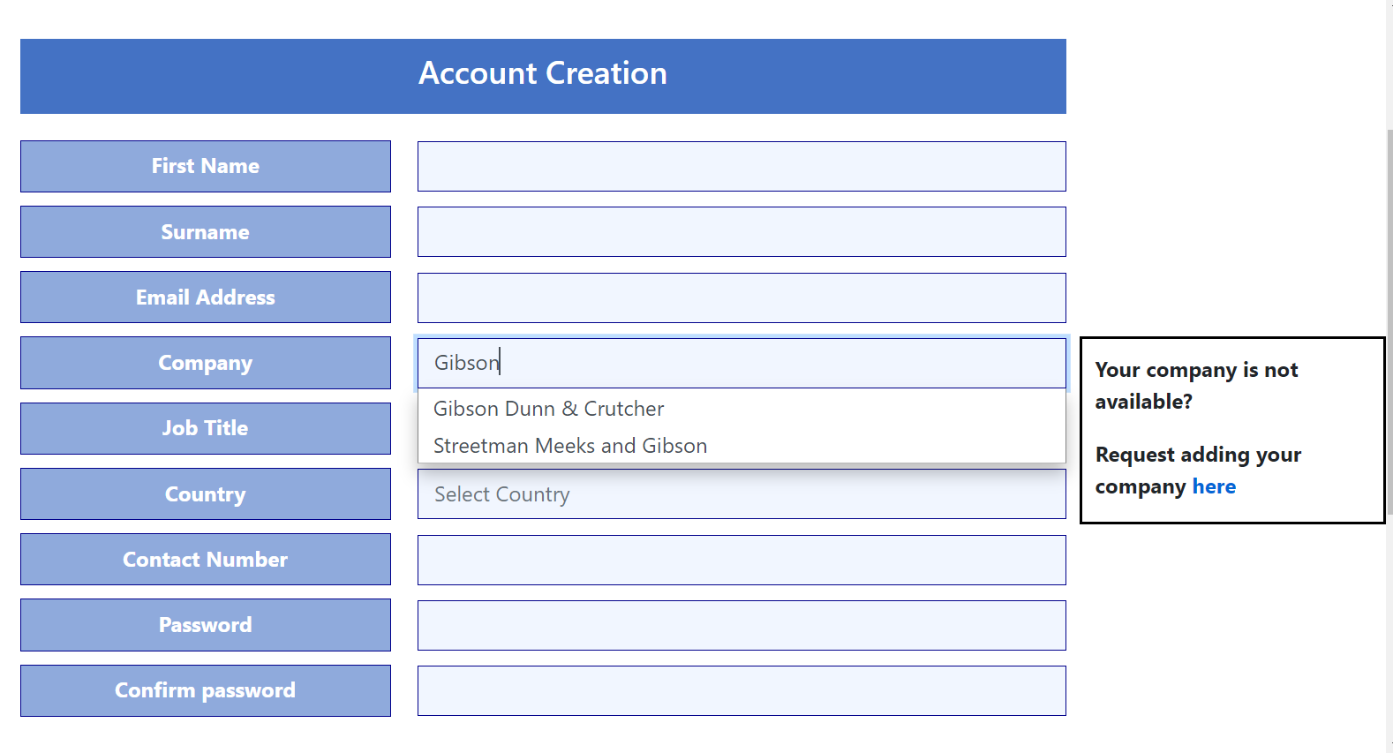
HOW TO SUBMIT
All questionnaires and client references must be submitted via the Accreditation Submission Portal
You must register in order to submit
  Register early!
Create your account
  Fill in all sections of the registration
  Begin typing your firm name in "Company" and wait for drop down menu to appear (about 15 seconds)
  Select your firm in the drop down as shown in the picture to the left
  If your firm does not appear in the drop-down menu, please request having your company added
  Begin typing in "Country" and select Canada from the drop-down menu (same 15 seconds!)
  If you don't receive an email confirmation, please let the Accreditation Portal team know.
Keep your password safe!
  If you lose/forget it, request a new one immediately. Don't wait until firm submissions are due. PASSWORDS EXPIRE AFTER 90 DAYS OF INACTIVITY, SO IF YOU HAVE NOT USED THIS PORTAL SINCE LAST YEAR, YOU’LL LIKELY NEED A NEW ONE.

Slide 9
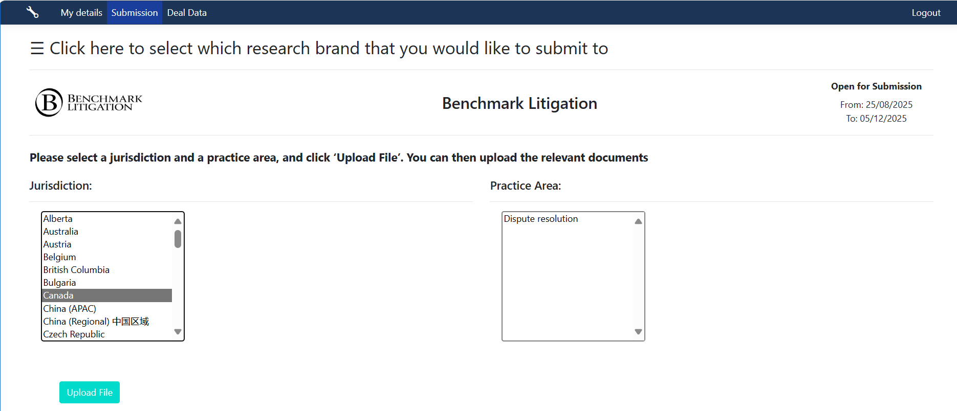
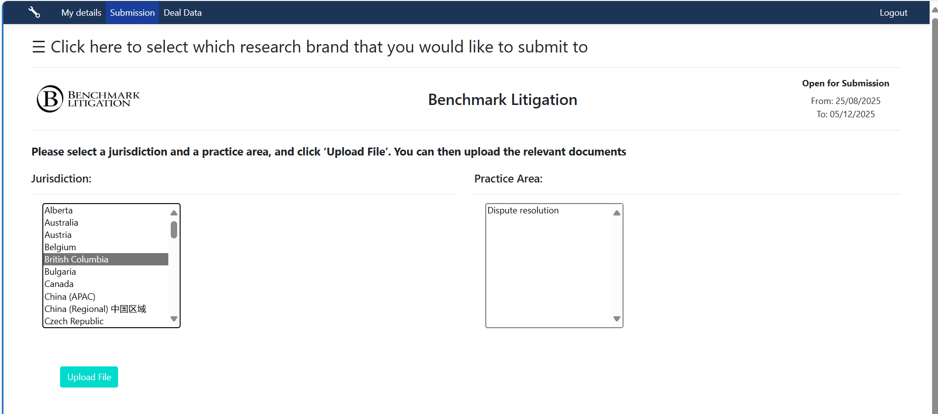
HOW TO SUBMIT: Continuation
For NATIONAL Firms
Select 'Canada' as the Jurisdiction
Select 'Dispute Resolution' as the Practice Area
Click 'Upload file' to upload your documents
To note: National firms should submit one form on behalf of the entire firm. Please DO NOT submit a separate document for each office or practice.
For PROVINCIAL Firms
Select your PROVINCE as the Jurisdiction
  Choose from: Alberta; The Atlantics; British Columbia; Manitoba, Ontario; Quebec; Saskatchewan
Select 'Dispute Resolution' as the Practice Area
Click 'Upload file' to upload your documents
Regional firms with offices in 2 provinces may submit for more than one Province, since each of their provincial offices can be very different.

Slide 10
PARTNER INTERVIEWS
SCHEDULED ON A FIRST-COME, FIRST-SERVE BASIS BETWEEN NOW AND JANUARY 23, 2026
  CAN BE CONDUCTED:
    LIVE IN-PERSON UPON REQUEST or
    VIA PHONE/ZOOM (NO CALLS TAKEN FROM VEHICLES.)
      8 PARTNERS MAX per IN-PERSON MEETING (90-MINUTE WINDOW PER FIRM) PARTNERS MUST BE PHYSICALLY PRESENT! IF CERTAIN PARTNERS ARE UNAVAILABLE FOR A SCHEDULED IN-PERSON MEETING, REMOTE MEETINGS CAN BE CONDUCTED AT A LATER DATE BEFORE JANUARY 23.
      5 PARTNERS MAX per ZOOM MEETING (60 MINUTES PER FIRM or FIRM OFFICE)
      2 PARTNERS MAX per PHONE CALL (60 MINUTES)
PARTNERS SHOULD BE READY TO DISCUSS:
  THEIR PAST YEAR IN LITIGATION AND DISPUTES (IN SOME CASES COMMENT MORE BROADLY ON THE FIRM OR THEIR DEPARTMENT, WHERE APPLICABLE) HOWEVER, A FULL DOSSIER OF CASE WORK IS NOT NECESSARY
  OFFER MARKET COMMENTARY, INCLUDING PEER REVIEW.
  POTENTIALLY DISCUSS NOVEL ISSUES OR TRENDS/PHENOMENA AFFECTING THEIR PRACTICE AND/OR CANADIAN LITIGATION MORE BROADLY.
ALL COMMENTARY IS OFF THE RECORD. NO QUOTES ARE EVER ATTRIBUTED.
START BOOKING INTERVIEWS EARLY TO GUARANTEE A PREFERRED TIME SLOT! IT IS NOT ADVISED TO WAIT UNTIL THE QUESTIONNAIRE DUE DATE.

Slide 11
FIRM RANKINGS
AS ALWAYS, BENCHMARK’S FIRM RANKINGS AIM TO FOCUS ON THE ELITE LEADERS IN THE LITIGATION MARKET. THEREFORE, WE USE A TWO-TIER RANKING SYSTEM.
RECOMMENDED – FIRMS THAT HAVE RECEIVED RECOGNITION AS LEADERS IN A PARTICULAR JURISDICTION OR PRACTICE AREA
HIGHLY RECOMMENDED – FIRMS THAT HAVE RECEIVED UNANIMOUS OR NEAR-UNANIMOUS RECOGNITION AS DOMINANT IN A PARTICULAR JURISDICTION OR PRACTICE AREA
SINCE WE ARE SPECIFICALLY FOCUSED ON LITIGATION AND DISPUTES, SIZE DOESN’T ALWAYS MATTER. SMALLER BOUTIQUE FIRMS CAN BE CONSIDERED DOMINANT IN THE LITIGATION COMMUNITY IN SOME JURISDICTIONS. LIKE ALL OF OUR FINDINGS, THESE ARE CONSTANTLY EVOLVING AND CAN CHANGE FROM YEAR TO YEAR.

Slide 12
LITIGATION STARS and FUTURE STARS
LITIGATION STARS ARE THOSE INDIVIDUALS WHO HAVE BEEN ACKNOWLEDGED AS ESTABLISHED LEADERS IN SPECIFIC JURISDICTION(S) OR PRACTICE AREA(S)
FUTURE STARS ARE THOSE WHO ARE DEEMED LIKELY TO BE LITIGATION STARS WITHIN THE NEXT TWO TO THREE YEARS MAXIMUM
LITIGATION STARS AND FUTURE STARS ALL MUST BE OF PARTNER LEVEL.
PRACTICE AREAS
ANY AREA OF LITIGATION IS FAIR GAME TO BE RECOGNIZED. THIS INCLUDES SMALLER, NICHE AREAS

Slide 13
SPECIAL HONO(U)RS
TOP 50 TRIAL LAWYERS IN CANADA – THE 50 LITIGATORS ACKNOWLEDGED THROUGHOUT THE COURSE OF THE RESEARCH FOR BENCHMARK CANADA 2026 AS BEING SPECIFICALLY NOTEWORTHY AS TRIAL LAWYERS. THIS LIST COVERS ALL JURISDICTIONS IN CANADA AND INCLUDES SEASONED PARTNERS AS WELL AS MORE RECENT ADDITIONS. INCLUDED AT PRESS TIME FOR BENCHMARK CANADA 2026.
TOP 100 WOMEN LITIGATORS IN CANADA – THE 100 WOMEN LITIGATORS ACKNOWLEDGED THROUGHOUT THE COURSE OF THE RESEARCH FOR BENCHMARK CANADA 2026 AS BEING PARTICULARLY EXEMPLARY. THIS LIST COVERS ALL JURISDICTIONS IN CANADA AND INCLUDES SEASONED PARTNERS AS WELL AS MORE RECENT ADDITIONS. INCLUDED AS A COMPONENT OF THE US EDITION OF TOP 250 WOMEN IN LITIGATION AND GOES TO PRESS AT THAT TIME (SUMMER 2026)
TOP 40 & UNDER LITIGATORS IN CANADA – THE TOP LITIGATORS AGED 40 AND UNDER ACKNOWLEDGED THROUGHOUT THE COURSE OF THE RESEARCH FOR BENCHMARK CANADA 2026 AS BEING PARTICULARLY EXEMPLARY. THIS LIST COVERS ALL JURISDICTIONS IN CANADA AND ALL NOMINEES MUST CONFIRM DOB TO BE LISTED. INCLUDED AS A COMPONENT OF THE US EDITION OF 40 AND UNDER LIST AND GOES TO PRESS AT THAT TIME (SUMMER 2026.)

Slide 14
PRACTITIONER SURVEY – WHY WE SEND THEM and WHAT WE GET FROM THEM?
PRACTITIONER SURVEYS ALLOW US TO GET TO KNOW PARTNERS BETTER, ESPECIALLY IF WE NEVER GOT A CHANCE TO MEET OR INTERVIEW THEM, AND IN MANY INSTANCES ALLOW US TO ESTABLISH CONTACT AND POTENTIALLY BUILD RELATIONSHIPS WHERE WE MAY NORMALLY NOT HAVE BEEN ABLE TO DO SO.
THEY ALSO ALLOW US TO MINE FOR ADDITIONAL DATA THAT HELPS US GAIN INSIGHT FROM PARTNERS – THEIR EXPERIENCES IN THE MARKET, THEIR RELATIONSHIPS WITH IN-HOUSE TEAMS, ADDITIONAL CASES THEY MAY WANT TO DISCUSS (WHETHER OR NOT THEY WERE IN THE FIRM QUESTIONNAIRE), HOW BENCHMARK COULD FURTHER BE OF VALUE TO THEM, ETC.
PRACTITIONER SURVEYS ARE SENT TO ALL CURRENTLY-RECOGNIZED LITIGATION PARTNERS. IT IS ALSO AN OPPORTUNITY FOR NON-RECOGNIZED PARTNERS TO PUT FORWARD ADDITIONAL CASEWORK FOR ADDED CONSIDERATION. COMPLETING THIS SURVEY DOES NOT GUARANTEE RECOGNITION.
THIS SURVEY IS NOT MEANT TO BE COMPLETED BY ANYONE IN THE BUSINESS DEVELOPMENT/MARKETING/COMMUNICATIONS CAPACITY.
IF THE PARTNERS ARE NOT INTERESTED IN COMPLETING THE SURVEY, SIMPLY DISREGARD.

Slide 15
WHY PARTICIPATE?
ENDORSEMENT FROM AN INDEPENDENT, JOURNALISTICALLY DRIVEN THIRD-PARTY RESOURCE THAT SPECIALIZES IN LITIGATION AND HAS BECOME A TRUSTED BRAND IN CANADA SINCE 2012
CONNECTION TO LBG’S GLOBAL NETWORK
OPPORTUNITIES TO BE RECOGNIZED FOR AWARDS, INVITED TO SPEAKING ENGAGEMENTS, INVITED TO PROVIDE THOUGHT LEADERSHIP FEATURES
A COMPETING FIRM IS MOST LIKELY ENGAGING AND POTENTIALLY GAINING AN ADVANTAGE FROM THE OPTICS

Slide 16

Questions?
Suggestions?
We’re all ears!
Contact Michael Rafalowich, Managing Editor and Head of Research at mrafalowich@benchmarklitigation.com

Slide 17
Reminder
RESEARCH TIMELINE
OCTOBER 1, 2025 –Documents available: Questionnaire & Client Referee template
OCTOBER 27, 2025 – JANUARY 23, 2026 – Partner interviews conducted
NOVEMBER 5, 2025 – Practitioner Survey distributed
DECEMBER 5, 2025 – DEADLINE for Research Documents
JANUARY 5, 2026 – Client Survey distributed
MARCH 23, 2026 – Awards Shortlist announced
MAY 6, 2026– Firm Rankings & Lawyer Rankings published
May 2026 – Awards Gala (exact date TBD)
THANK YOU

