Slide 1

BENCHMARK CANADA 2025
Research cycle overview

Slide 2
RESEARCH TIMELINE
OCTOBER 8, 2024 – research begins, questionnaires made available
OCTOBER 21, 2024 – JANUARY 17, 2025 – partner interviews conducted
DECEMBER 6, 2024 – questionnaire due date
DECEMBER 9, 2024 – practitioner survey distributed
JANUARY 6, 2025 – client survey distributed
JANUARY 31, 2025 – notifiers to firms on ranking designations
MARCH 26, 2025 – awards shortlist announced
MAY 1, 2025– firm rankings and stars published

Slide 3
PARTNER INTERVIEWS
SCHEDULED ON A FIRST-COME, FIRST-SERVE BASIS BETWEEN NOW AND JANUARY 17, 2025
CAN BE CONDUCTED LIVE IN-PERSON UPON REQUEST OR VIA PHONE OR ZOOM (NO CALLS TAKEN FROM VEHICLES.)
8 PARTNERS MAX PER IN-PERSON MEETING, FOR 90-MINUTE WINDOW PER FIRM
2 PARTNERS MAX PER PHONE CALL OR 5 PARTNERS MAX PER ZOOM MEETING. 60 MINUTES PER FIRM OR FIRM OFFICE
PARTNERS SHOULD BE READY TO DISCUSS THEIR PAST YEAR IN LITIGATION AND DISPUTES (IN SOME CASES COMMENT MORE BROADLY ON THE FIRM OR THEIR DEPARTMENT, WHERE APPLICABLE) AND OFFER MARKET COMMENTARY, INCLUDING PEER REVIEW. HOWEVER, A FULL DOSSIER OF CASE WORK IS NOT NECESSARY. ALSO POTENTIALLY DISCUSS NOVEL ISSUES OR TRENDS/PHENOMENA AFFECTING THEIR PRACTICE AND/OR CANADIAN LITIGATION MORE BROADLY. ALL COMMENTARY IS OFF THE RECORD. NO QUOTES ARE EVER ATTRIBUTED.
START BOOKING INTERVIEWS EARLY TO GUARANTEE A PREFERRED TIME SLOT! IT IS NOT ADVISED TO WAIT UNTIL THE QUESTIONNAIRE DUE DATE.

Slide 4
COMPLETION OF THE QUESTIONNAIRE
THE PURPOSE OF THE QUESTIONNAIRE IS TO TELL THE STORY OF THE FIRM’S LITIGATION CAPACITY, SPECIFICALLY AS IT PERTAINS TO THE PAST YEAR:
HIGHLIGHT KEY PRACTICE AREAS (WHERE APPLICABLE) IN WHICH THE FIRM HAS PRACTICULARLY EXCELLED IN THE PAST YEAR
MENTION KEY PARTNERS WHO YOU WOULD CONSIDER THE FIRM’S LEADERS AND UP-AND-COMERS IN THESE KEY AREAS
PROVIDE DETAILS ON CASES AND MANDATES THAT DEMONSTRATE THESE STRENGTHS
MARK CLEARLY IN RED ANY CONFIDENTIAL INFORMATION THAT YOU DO NOT WANT PUBLISHED

Slide 5
CASE SECTION EXAMPLE
Case name
Nominate for award (Y/N) (case name is necessary for impact award nominations)
Dispute resolution practice area
Closed or ongoing?
Date completed (if relevant)
Client(s) advised
Lead partner involved
Other lawyers involved
Your firm’s role
Other law firms and their roles
CONFIDENTIAL (Y/N)
Description
Please state the significance, impact and outcome of the case
CASE HIGHLIGHTS

Slide 6
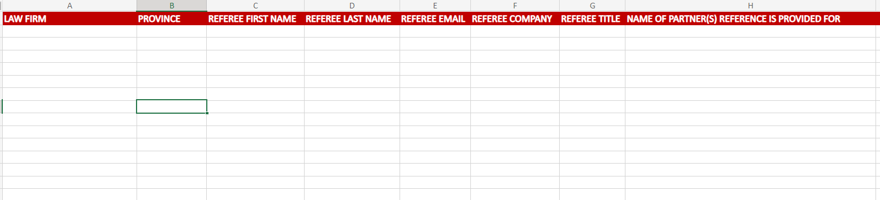
COMPLETION OF THE CLIENT & PROFESSIONAL REFERENCES
PROVIDE RELEVANT CLIENT REFERENCES THAT CAN BE CONTACTED – TIMELINESS IS PARTICULARLY OF THE ESSENCE WITH THIS PORTION OF THE QUESTIONNAIRE.
IF YOU NEED AN EXTENSION WITH ANY OTHER PORTIONS OF THE QUESTIONNAIRE, THESE CAN BE GRANTED, WITHIN REASON, BUT BEING TIMELY WITH CLIENT CONTACTS ALLOWS FOR MORE CERTAINTY OF A RESPONSE.

Slide 7
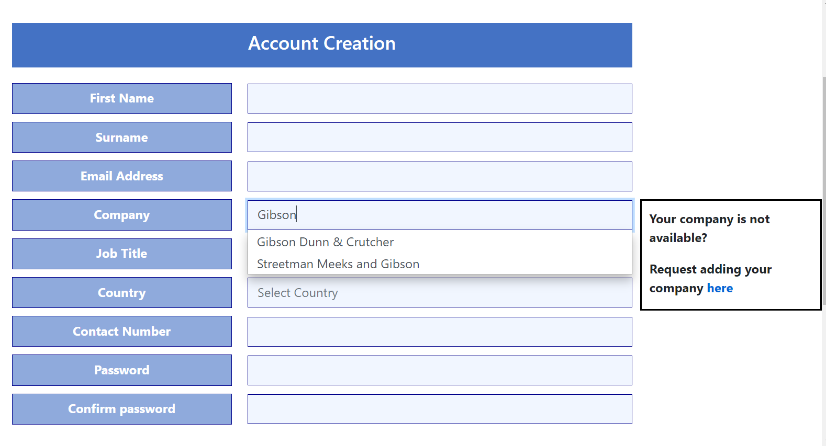
HOW TO SUBMIT
All questionnaires and client references must be submitted via the Accreditation Submission Portal
submissions.legalbenchmarkinggroup.com/Identity/Account/Login
You must register in order to submit
  Register early!
Create your account
  Fill in all sections of the registration
  Begin typing your firm name in "Company" and wait for drop down menu to appear (about 15 seconds)
  Select your firm in the drop down as shown in the picture to the left
  If your firm does not appear in the drop-down menu, please request having your company added
  Begin typing in "Country" and select Canada from the drop-down menu (same 15 seconds!)
  If you don't receive an email confirmation, please let the Accreditation Portal team know.
Keep your password safe!
  If you lose/forget it, request a new one immediately. Don't wait until firm submissions are due
Due to GDPR requirements we will no longer accept submissions via email. Please only use the submission portal.

Slide 8
BENCHMARK RANKINGS
AS ALWAYS, BENCHMARK’S FIRM RANKINGS AIM TO FOCUS ON THE ELITE LEADERS IN THE LITIGATION MARKET. THEREFORE, WE USE A TWO-TIER RANKING SYSTEM.
RECOMMENDED – FIRMS THAT HAVE RECEIVED RECOGNITION AS LEADERS IN A PARTICULAR JURISDICTION OR PRACTICE AREA
HIGHLY RECOMMENDED – FIRMS THAT HAVE RECEIVED UNANIMOUS OR NEAR-UNANIMOUS RECOGNITION AS DOMINANT IN A PARTICULAR JURISDICTION OR PRACTICE AREA
SINCE WE ARE SPECIFICALLY FOCUSED ON LITIGATION AND DISPUTES, SIZE DOESN’T ALWAYS MATTER. SMALLER BOUTIQUE FIRMS CAN BE CONSIDERED DOMINANT IN THE LITIGATION COMMUNITY IN SOME JURISDICTIONS. LIKE ALL OF OUR FINDINGS, THESE ARE CONSTANTLY EVOLVING AND CAN CHANGE FROM YEAR TO YEAR.

Slide 9
LITIGATION STARS AND FUTURE STARS
LITIGATION STARS ARE THOSE INDIVIDUALS WHO HAVE BEEN ACKNOWLEDGED AS ESTABLISHED LEADERS IN SPECIFIC JURISDICTION(S) OR PRACTICE AREA(S)
FUTURE STARS ARE THOSE WHO ARE DEEMED LIKELY TO BE LITIGATION STARS WITHIN THE NEXT TWO TO THREE YEARS MAXIMUM
LITIGATION STARS AND FUTURE STARS ALL MUST BE OF PARTNER LEVEL.
PRACTICE AREAS
ANY AREA OF LITIGATION IS FAIR GAME TO BE RECOGNIZED. THIS INCLUDES SMALLER, NICHE AREAS

Slide 10
SPECIAL HONO(U)RS
TOP 50 TRIAL LAWYERS IN CANADA – THE 50 LITIGATORS ACKNOWLEDGED THROUGHOUT THE COURSE OF THE RESEARCH FOR BENCHMARK CANADA 2025 AS BEING SPECIFICALLY NOTEWORTHY AS TRIAL LAWYERS. THIS LIST COVERS ALL JURISDICTIONS IN CANADA AND INCLUDES SEASONED PARTNERS AS WELL AS MORE RECENT ADDITIONS. INCLUDED AT PRESS TIME FOR BENCHMARK CANADA 2025.
TOP 100 WOMEN LITIGATORS IN CANADA – THE 100 WOMEN LITIGATORS ACKNOWLEDGED THROUGHOUT THE COURSE OF THE RESEARCH FOR BENCHMARK CANADA 2025 AS BEING PARTICULARLY EXEMPLARY. THIS LIST COVERS ALL JURISDICTIONS IN CANADA AND INCLUDES SEASONED PARTNERS AS WELL AS MORE RECENT ADDITIONS. INCLUDED AS A COMPONENT OF THE US EDITION OF TOP 250 WOMEN IN LITIGATION AND GOES TO PRESS AT THAT TIME (SUMMER 2025)
TOP 40 AND UNDER LITIGATORS IN CANADA – THE TOP LITIGATORS AGED 40 AND UNDER ACKNOWLEDGED THROUGHOUT THE COURSE OF THE RESEARCH FOR BENCHMARK CANADA 2025 AS BEING PARTICULARLY EXEMPLARY. THIS LIST COVERS ALL JURISDICTIONS IN CANADA AND ALL NOMINEES MUST CONFIRM DOB TO BE LISTED. INCLUDED AS A COMPONENT OF THE US EDITION OF 40 AND UNDER LIST AND GOES TO PRESS AT THAT TIME (SUMMER 2025.)

Slide 11
INDIVIDUAL QUESTIONNAIRES – WHY WE SEND THEM AND WHAT WE GET FROM THEM
INDIVIDUAL QUESTIONNAIRES ALLOW US TO GET TO KNOW PARTNERS BETTER, ESPECIALLY IF WE NEVER GOT A CHANCE TO MEET OR INTERVIEW THEM, AND IN MANY INSTANCES ALLOW US TO ESTABLISH CONTACT AND POTENTIALLY BUILD RELATIONSHIPS WHERE WE MAY NORMALLY NOT HAVE BEEN ABLE TO DO SO.
THEY ALSO ALLOW US TO MINE FOR ADDITIONAL DATA THAT HELPS US GAIN INSIGHT FROM PARTNERS – THEIR EXPERIENCES IN THE MARKET, THEIR RELATIONSHIPS WITH IN-HOUSE, ADDITIONAL CASES THEY MAY WANT TO DISCUSS (WHETHER OR NOT THEY WERE IN THE FIRM QUESTIONNAIRE), HOW BENCHMARK COULD FURTHER BE OF VALUE TO THEM, ETC.
THESE ARE SENT TO ALL PARTNERS DUE TO BE LISTED AS LITIGATION STARS ONCE WE HAVE ESTABLISHED OUR LIST. THEY ARE NOT MEANT TO BE ADDRESSED BY ANYONE IN THE BUSINESS DEVELOPMENT/MARKETING/COMMUNICATIONS CAPACITY. IF THE PARTNERS ARE NOT INTERESTED IN COMPLETING THEM, THEY CAN SIMPLY DISREGARD.

Slide 12
WHY PARTICIPATE?
ENDORSEMENT FROM AN INDEPENDENT, JOURNALISTICALLY DRIVEN THIRD-PARTY RESOURCE THAT SPECIALIZES IN LITIGATION AND HAS BECOME A TRUSTED BRAND IN CANADA SINCE 2012
CONNECTION TO LMG’S GLOBAL NETWORK
OPPORTUNITIES TO BE RECOGNIZED FOR AWARDS, INVITED TO SPEAKING ENGAGEMENTS, INVITED TO PROVIDE THOUGHT LEADERSHIP FEATURES

Slide 13
Questions?
Suggestions?
We’re all ears!

