Slide 1

2027 Benchmark Litigation USA Research Webinar
Tuesday, February 10, 2026
2pm ET
Speaker:
Michael Rafalowich, Managing Editor and Head of Research

Slide 2
Today’s Agenda
Benchmark Research Process + NEW DEVELOPMENTS
Completing the Questionnaire ​
Interviews ​
Benefits of Participation​
Submission Strategies ​
Benchmark Rankings and Special Honors

Slide 3
About Benchmark Litigation
Benchmark Litigation is the only study to focus exclusively on litigation
Research Timeline: February 2026 – September 2026
Researchers are based in New York (although will be principally remote)
It is FREE to participate and be included in rankings
Content: firm rankings, firm analysis, special honors lists, litigation and future stars

Slide 4


New Developments for 2027
granular COVERAGE of major metropolises within select states
New City Ranking Tables
New National Practice Area Tables
Consumer class action
Privacy/data security
(class action and single action)
Health and Life Sciences litigation
(Non-IP)
New State Practice Area Tables
California: Employment; Tech patents
Florida: Real estate; International Arbitration
Illinois: Product liability;
Antitrust/competition
Massachusetts: Life sciences; tech patents
Texas: Energy; IP
  CA: Los Angeles; San Francisco; San Diego; Silicon Valley​
  FL: Miami; Tampa​
  NC: Charlotte; Raleigh​
  OH: Cleveland; Cincinnati
  PA: Philadelphia; Pittsburgh
  TX: Houston; Dallas; Austin

Slide 5
Research Timeline
February 10
Research Cycle Launches
April 24
SUBMISSION DEADLINE
July 1
Late October
Benchmark Litigation USA rankings are released online
Relevant research documents are posted online
Top 250 Women in Litigation results published
August
Interview process ends
May/June
Client/Professional References Survey launches in May
Interviews begin – can be scheduled from 10am to 5pm ET
Practitioner Survey due in June
March 25
Practitioner Survey launches
Firm Questionnaires + Referral Docs due
June 27
Client/Professional References Survey due
40 and Under results published

Slide 6
Sources of Information
Firm questionnaires
Attorney interviews
Client/Professional feedback from surveys
News and other external sources
Independent research

Slide 7

Completing your Submission
Download the necessary documents:
  2027 Research Questionnaire
  Client Referee Template (Excel spreadsheet)
These documents are available as attachments to this Webinar.
  They can also be found on the Benchmark USA Methodology page​

Slide 8
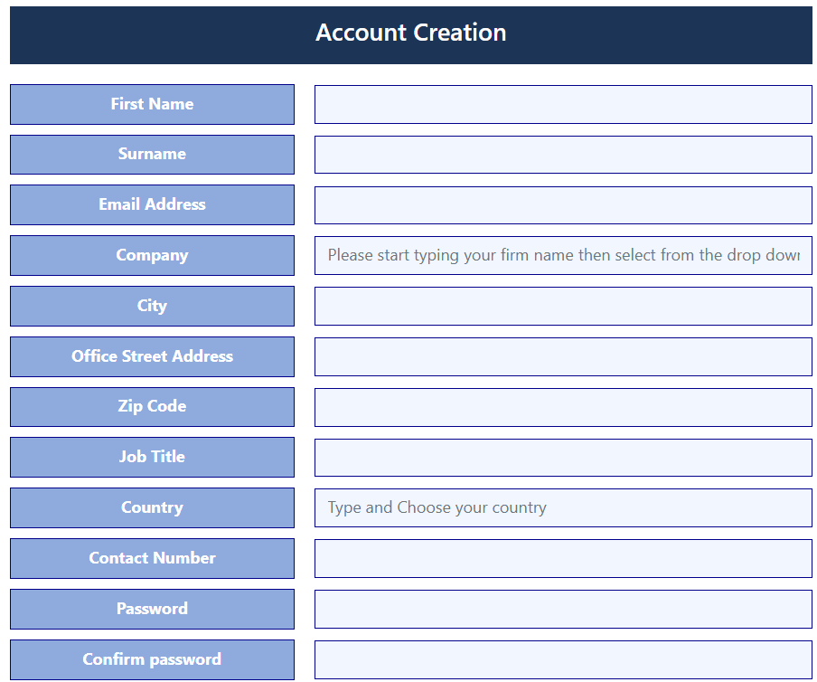
Registering on the Submission Portal
You must register in order to submit - Register early!
Create your account - fill in all sections of the registration
Begin typing your firm name in "Company"
Wait for drop down menu to appear (about 3 seconds)
Select your firm in the drop-down
  If your firm does not appear in the drop-down menu, please request having your company added
Begin typing in "Country" and select United States from the drop-down menu (same 3 second-wait)
If you don't receive an email confirmation, please contact the Accreditation Portal team at accreditation@legalbenchmarkinggroup.com.
Passwords automatically expire if inactive for 90 days – if this is the case, or if you've lost/forgotten it, please reset or request a new one immediately.
  Do NOT wait until firm submissions are due to request/reset your password.

Slide 9
How to Submit on the Submission Portal
After filling out the relevant research documents and registering for the portal, you are ready to submit!
PLEASE NOTE: EACH FIRM SHOULD ONLY HAVE ONE SUBMISSION / QUESTIONNAIRE – NO MATTER HOW MANY LOCATIONS IT HAS!
Select 'Benchmark Litigation' from the listed brands (click on the three lines on the upper left)
Select either the 'United States (National/Multi-State)' option or ‘United states (Single-State)’.
  National/Multi-State submission: firms with more than one location (e.g., New York and California).
  Single-state submission: firms with only one location (e.g., only Ohio).
If selecting 'United States (Single-State)', a drop-down of all 51 options will appear for you to choose the one state you're submitting for.
  Your firm should only have one location, please select that state.
When selecting practice area, you MUST SELECT 'Dispute Resolution' as the default practice area so we can properly account your submission for Benchmark Litigation, and no other brands.
Upload your questionnaire and client referee spreadsheet. While you can take liberties with the Word portion of the questionnaire, client/professional referees CANNOT BE ALTERED.
  Any referee spreadsheets that do not conform to this template will NOT be included in the contact campaign.

Slide 10
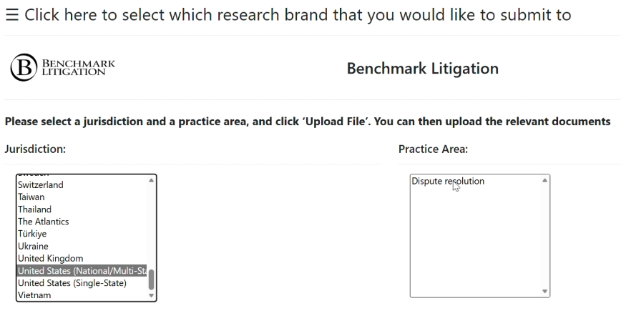
How to Submit on the Portal (Photos)

Slide 11
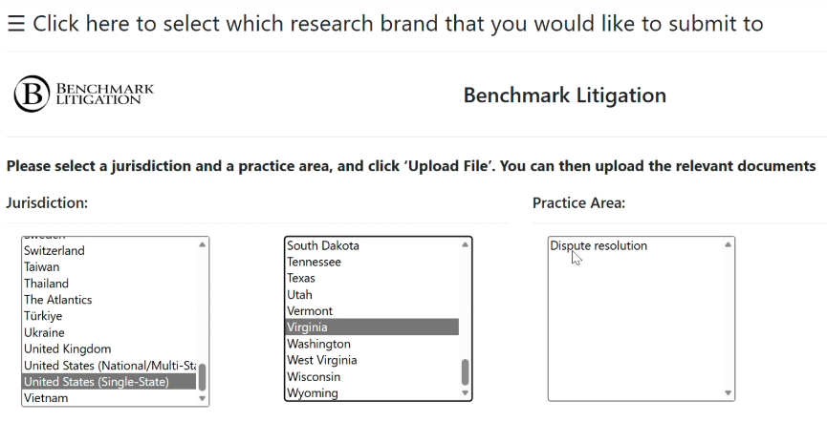
How to Submit on the Portal (Photos)

Slide 12
Submission Tips
/
Register​
Do this immediately! You don't want to be late to submit. ​
Meet the Deadline
Begin early (Feb 10th) to avoid bottlenecks and time crunches on your part! Starting early gives you an advantage.​
Avoid Jargon, Spin and Puffery
Be direct. Researchers aren’t lawyers, and excessive fluff slows them down.
Choose the Best Cases​
Highlight your strongest matters in the case summary section & lead with your top cases -- don’t bury them.
Tell a Story​
Use this opportunity to provide an illustrative account of the past 12 months of your firm's litigation capacity. ​
Complete the Form Thoughtfully​
While you don't want to write too much, you also don't want too little.​

Slide 13
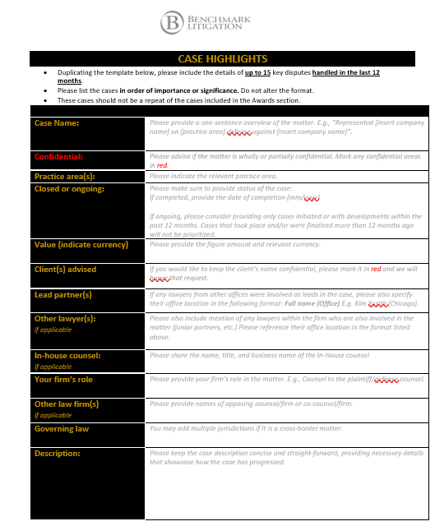
The Case Summary Section
The case summary section (image to the left) is where you get the opportunity to extrapolate on the work the firm and its partners have been engaged in over the past 12 months (ongoing cases are welcomed).
THIS IS THE MOST CRITICAL PORTION OF THE QUESTIONNAIRE.
Editorial analyses of firms are never guaranteed, but if this section of the questionnaire is not complete or lacking substantial content, it is often impossible for Benchmark reporters to compose any meaningful analysis.
Required fields to fill out:
The case name (if it is being put forward for consideration as an “impact case” award at our annual award ceremony.)
Date completed or whether ongoing
Lead partner(s) and other firm partners
EXTREMELY IMPORTANT! We ask that you mark any/all confidential information in red ink in your submission so we do not report on it.

Slide 14

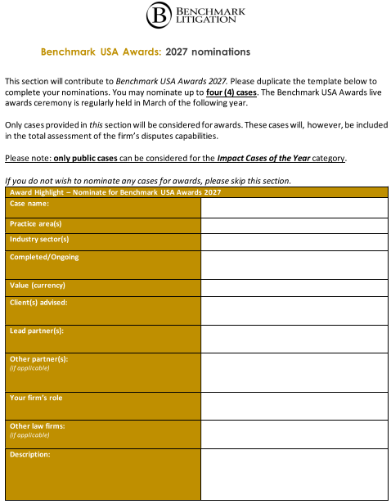
The Awards Section
The Benchmark Litigation US Awards are based on the casework submitted through the questionnaire. ​
​
The “impact case” awards assessment is case-based and should include matters that are landmark, novel and/or precedent-setting in nature. ​
​
Confidential cases can be put forward and used for consideration of firm and lawyer categories but CANNOT be considered for impact case awards, as these would need to be announced publicly at the event. All submitting firms who put casework forward will be considered.​
​
This research cycle will be reflected in the March 2027 event. ​

Slide 15
Client/Professional References
Submitting client/professional references is a key component to our research.
REFERENCES MUST BE SUBMITTED IN THE FORMAT OF THE TEMPLATE WE PROVIDE. ANY THAT ARE NOT PROVIDED IN THIS FORMAT WILL NOT BE CONTACTED.
How to select client references:
    Think about the client’s personality – are they more verbose or more circumspect?
    Think about how deep the relationship is – will this client actually be able to offer substantive responses or one-word answers?
    Consider accessibility – Will we be able to actually reach them & will they fill out the survey we send them?
Best practices to submit your client/professional references: ​
    Provide clients that your litigation department has advised over the past three years or, if not a client, a professional reference that can vouch for specific members of your litigation team​
    Notify confirmed references in advance so that they actually answer emails and not disregard them as spam​
    Tie in to referenced matters where possible​
  Alternative types of references to consider: opposing or co-counsel, retired judges, etc.​

Slide 16
Attorney Interviews Expectations
The interview is not simply a firm promotional opportunity – peer review and market commentary are essential to the integrity of the Benchmark research process so partners should be prepared to speak on this. If they don’t want to, we have the right to decline the interview.
Our goal is to conduct an honest internal assessment of your firm so when choosing interviewee candidates, put forth your most prominent players and/or up-and-comers that you can say with confidence should be recognized.
The partner interviews are a way for us to develop relationships with and get personal perspectives and commentary from a firm’s litigation partners.
Interviews (phone or video) run 10am–5pm ET, Mon–Fri, ending June 27.
Phone Interviews:
1–5 calls max per firm, max 3 partners per call; 20–60 mins. Firm provides toll‑free line. No calls from a car.
Video Interviews:
1–5 meetings max per firm, max 10 partners; 60–90 mins. Avoid overloading sessions to ensure quality and complete intel gathering.

Slide 17
Ultimately there are no guarantees, but here’s what you can do to maximize your impression.
How can you improve your ranking?
Put thought into the questionnaire:
  Choose matters that best reflect the firm’s litigation practice(s) over the past 12 months
  Keep it simple but thorough
  Be aware of due dates and START EARLY!
  Target client and/or professional references
Strategize interviews:
  Reflect the firm’s strongest key players over the last 12 months - whether that's seasoned, established partners, younger ‘future star’ candidates, or a mix of both
  If any part of the practice is underrepresented or missing in Benchmark, flag it and provide supporting evidence or references.
  Final Consideration:
    Honestly consider how much emphasis the firm puts on the LITIGATION and DISPUTES practice.
    Not all firms are going to be known for litigation, even if it's a dominant player in other areas of law.

Slide 18
Why participate in Benchmark?
Increased visibility and potential referrals for your firm – audience is expanding rapidly, and we are expanding globally!
Third-party validation in an independent and impartial journalistic study
Stand apart from the pack – Benchmark is the only source exclusively dedicated to litigation and disputes. If you are looking to promote or emphasize this aspect of your practice, there simply is no more effective vehicle for doing this.
Gain an advantage. Your competitors are most likely doing it and benefiting from it.

Slide 19
Benchmark Special Honors List
Top 250 Women in Litigation​: Published annually in August focusing on leading 250 women litigators as identified through the research process.
40 & Under​: Published annually in July focusing on practitioners, all aged 40 or younger, who are deemed the most promising and emerging talent in the respective litigation communities.
  A confirmed date of birth must be provided for all candidates put forth for this honor. We cannot rank candidates without proof of age. Candidates must be 40 years or younger as of August 1st, 2026 for this year's edition.
Due to the earlier release date of Top 250 and 40 & Under, any questionnaires containing nominations MUST be provided promptly by the submission deadline – Friday April 24th. Any questionnaires submitted past the deadline are NOT guaranteed to be considered.
Top 100 Trial Lawyers: Appears in the master edition in the fall of 2026. Special feature list and accompanying novel editorial highlighting the leading trial lawyers (as opposed to litigators) in the US as discovered through Benchmark research.

Slide 20
What do our distinctions mean?
Litigation Stars​: Partners identified as established key players in the market via interviews the Benchmark research team conducts with prominent litigators, in addition to client feedback and research avenues. ​
National Stars​: Some litigators who are specialists in certain key practice areas will be identified as National Stars – this means that regardless of where they are physically domiciled, peers and clients across the country identify them as leaders. National stars are by default also ranked locally.​
Future Stars: Partners who been identified as individuals who are very likely to attain increased recognition within the market, based on growing stature and involvement in high-profile work, within the next two editions of Benchmark. The Future Star ranking does not necessarily equate with youth or lack of experience. Future stars cannot appear as National Stars.
National firms​: The elite group of firms that have been identified as dominant players, earning coast-to-coast recognition.​
State firms: Firms that operate in one state or jurisdiction and have been acknowledged as leaders in this jurisdiction.​

Slide 21
Stay In Touch
Research and Editorial:
Michael Rafalowich, Managing Editor and Head of Research
Email: mrafalowich@benchmarklitigation.com
Makenzie Rodrigues, Research Project Manager
Email: makenzie.rodrigues@benchmarklitigation.com
Blaike Parker, Research Analyst, 40 & Under Project Lead
Email: blaike.parker@benchmarklitigation.com
Business Development:
Rebecca Synnott, Head of Business Development
Email: Rebecca.Synnott@benchmarklitigation.com
Marketing:
Joseph Cousins, Marketing Manager
Email: joseph.cousins@legalbenchmarkinggroup.com

Slide 22

Q & A
For any questions not answered, please refer to this PowerPoint deck, our Methodology page, FAQs, or reach out via email.

